Slide 1
Social skill Lessons for Families
Developed by Dawn Varney, LICSW
Southern NH Services, Inc.
based on Pyramid Model Practices

Slide 2
Overview
Goals of social skill lessons
Increase Emotional literacy skills
Manage frustration and anger
Gain cooperative play skills
Notes:
These skills provide a foundation for school readiness and success in life.

Slide 3
Lessons
7 Lessons
Lesson 1-Establish Rules/Know your feelings:
Lesson 2-Dealing with Feeling Mad/Tucker the Turtle
Lesson 3-Dealing with mistakes
Lesson 4-Problem Solving
Lesson 5-Sharing
Lesson 6-Playing with others
Lesson 7-Give a Compliment/Gratitude
Notes:
These lessons can be provided in small groups or with a classroom of children. These practices are built into the classroom environment and materials can be provided for home. They build off each other and include repetition to build proficiency.

Slide 4
Pyramid Model
The Pyramid Model
for Supporting Social Emotional Competence in Infants and Young Children
is a conceptual framework of evidence-based practices for promoting young children’s healthy social and emotional development.
Notes:
Creates a structure for promoting positive behaviors through teaching and acknowledgement.
These concepts can be universal and will be best if promoted at school and home.
This is a tiered approach with most of the practices focused on all of the children, some practices focused on some of the children and individual focus for a few children.
These social skills are intended for all children in our program, but the format of the lessons helps to reinforce these strategies in a smaller setting to strengthen the effectiveness. It is like a booster shot.

Slide 5
Lesson 1- Establish Rules/Know your Feelings
Classroom rules
Be Safe, Be Kind, Be Careful with our things
How to Create Rules:
▶ Identify 3-5 rules that are important for your family.
▶ Write down the rules as “do’s” (instead of “don’ts”).
▶ Pick rules that apply to situations where your child needs reminders.
▶ Pick rules that your child can learn to do (e.g., appropriate for your child’s age
and abilities).
▶ Make a rules chart. Add a picture that shows your child following the rule.
Have your child help or watch you make the chart
https://challengingbehavior.cbcs.usf.edu/docs/Rules_Tipsheet_Home.pdf
Notes:
Our classroom rules provide a foundation for the classroom and this group. They can be easily translated to home
What do these rules mean to you? How can you encourage at home?
What are some expectations you have for your child at home? How can you frame these positively (no yelling to inside voices)

Slide 6
Introductions
We ask children to practice this social skill each week
“My name is . . .”
Notes:
This ensures that all children participate at their ability. We work to have them make the whole statement vs. just stating their name.
They will be asked to participate in additional ways as the group progresses.
How do you support your child engaging with other children in your family or community?

Slide 7
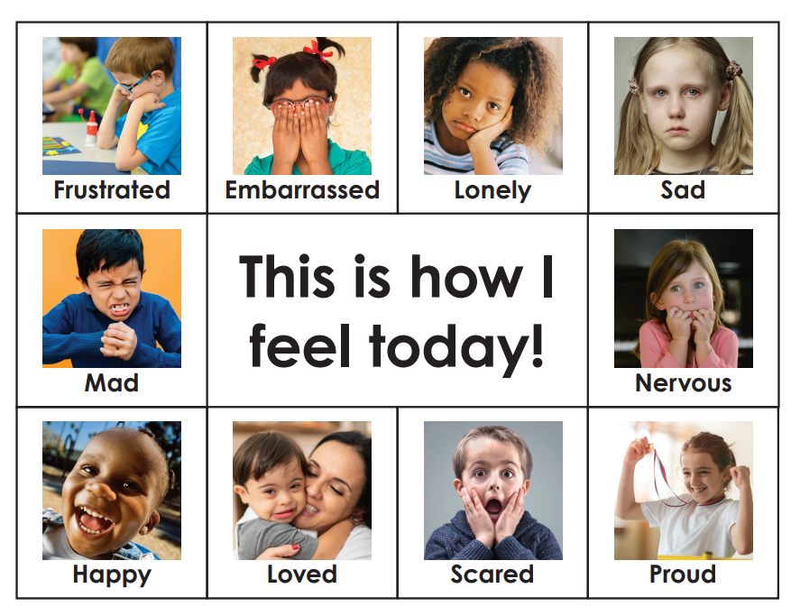
Introducing Feelings
Labeling feelings
Using visuals
Scripted Stories-Feeling Book
Modeling
Increasing acceptance of all feelings
Notes:
Regulating emotions (and sometimes behavior) begins with identifying the emotion
We want children to feel comfortable experiencing a range of emotions.
What does this look like in your household or your culture?
We may ask them to tell us more about when, why or what has made them feel this way. Teachers and facilitators should model this and with some variety so children don’t get stuck on the same few feelings. It is also possible to have multiple feelings at a time
We use a scripted story each week to promote the lessons. This provides a structure for their learning concepts. There are many great books that promote social and emotional skills. We use stories from the Pyramid Model for most weeks.
One way we practice feelings is by acting them out. Children will have a chance to be a variety of animals with different feelings. This introduces the idea that feelings don’t just live on our faces, but in our whole body.
We take 3 breaths together. Children will learn to focus on their breath. Breaths should be from their belly and slowly breathe in, and slowly breathe out. We repeat the breaths 3 times. This is a great exercise to regulate the body, calm our nervous system, etc. It is tied to later skills that require managing behavior and problem solving. Ask children to notice how their body is feeling more relaxed after the breaths.

Slide 8
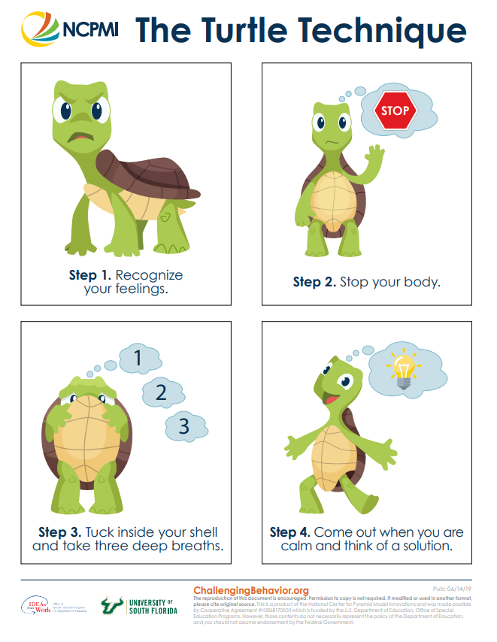
Lesson 2- Dealing with Feeling Mad/Tucker the Turtle
Review
Introductions and identify feelings
Tucker the Turtle
Identify that something happened that made us mad
Stop, keep hands feet and yelling to our self
Take 3 breaths
Think of a Solution
https://challengingbehavior.cbcs.usf.edu/docs/TuckerTurtle_Story_Home.pdf
Notes:
Each week will build on the previous week, so there is a quick review of the rules. Children introduce themselves and let us know how they are feeling today.
Tucker the Turtle is a mascot for feeling angry or frustrated.
We can talk about what are some ways to express our anger and frustration and also to try to feel better (breathing, getting a hug, telling someone, go to a quiet place, drinking water, etc.)
What are some times that you or your child get frustrated or angry. What do you do? What are some solutions?
The children make a turtle with pieces and a paper plate. You can use this to show how Tucker tucks into his shell to calm and then he comes out.

Slide 9
Practice Thinking Like a Turtle
Teach your child the steps of how to control feelings and calm down (“think like a turtle”).
Step 1: Recognize your feelings.
Step 2: Stop your body.
Step 3: Tuck inside your “shell” and take 3 deep breaths.
Step 4: Come out when you are calm and think of a solution.
Turtle Technique Tips
Practice tucking like a turtle when your child is calm.
Throughout the day, make time to practice taking 3 deep breaths.
Model using the calming steps when your feelings are strong.
Practice these steps frequently during routines (e.g., before playing with siblings, while reading a book, before chores, etc.).
Use the cue cards when practicing the steps.
Prepare for and help your child handle possible disappointment or change by reminding them to tuck and think like a turtle when they feel angry or mad.
Offer lots of encouragement when your child tries to use the steps.
Recognize and comment positively when your child stays calm.
Help all family members know the Turtle Technique.
Notes:
Thinking like a turtle takes practice. Remember to teach and practice when everyone is calm.

Slide 10
Think of Solutions
Help Children Think of Possible Solutions
Ask for help.
Say “Please stop.”
Wait and take turns.
Get a timer.
Ask for a hug.
Take a break.
Say, “Will you play with me?”
Share.
Use kind words.
Create your own!

Slide 11
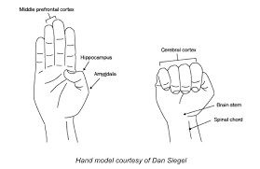
Regulation and the Brain
Flip our Lid (Dan Siegel’s brain model)
Make a fist with thumb tucked inside
Now lift your fingers
Notes:
Tucker represents what happens when the brain’s alert system is activated.
This is a visual of our brain. When a stressful event happens, our brain activates the alert system (the thumb inside the fist). This part of the brain sends the body into fight, flight, freeze modes. We often see hitting, kicking, yelling (fight), running, climbing (flight), withdrawal (freeze). The front part of the brain is no longer available at this time. We have flipped our lid (open the fingers of the hand to expose the thumb).
When this happens, our goal is to support regulation (not self-regulation). Breathing is one of the best ways to do this. Building other simple activities that help to soothe the child in this state are useful.

Slide 12
Lesson 3- Dealing with Mistakes
Review and introductions
Feelings and Tucker
Mistakes and learning
Notes:
Repetition is built in so children continue practicing introducing themselves and labeling feelings. We also review breathing like Tucker.
We want to normalize mistakes so children can work through solutions and build their resilience.
There are many examples of mistakes. It might be simple like when they are learning to draw and it doesn’t come out right. They might break something. They may have hurt someone or gotten hurt.

Slide 13
Mistakes at Home
Mistakes are normal!!
Encourage honesty
Reduce negative response
Promote problem solving
Try again
Notes:
We use an activity to demonstrate practicing. We toss a bean bag into a bucket. Sometimes we miss and we try again. We might get frustrated.
Children may not admit to doing something to avoid a consequence or negative response. How can we encourage them to be honest?
We read Minnie Makes a Mistake. The sister wants to play alone and tells the younger sister to go away, she smells. The father helps them know it will be okay and helps the sisters to make up.

Slide 14
Positive Behavior
Separating behavior from the child
“I don’t like it when you. . .” vs. “You are being bad”
Specific positive Feedback
Verbal Encouragement
u “You are working so hard on…”
u “You must feel proud of yourself for…”
u “Thank you for helping me…”
u “What a great listener you are, you…”
u “Way to go! You ____ all by yourself!”
u “You are being a helper when you…”
u “Your brother/sister looks so happy when you…”
u “You are really growing up because you…”
u “You were so patient when you…”
u “That’s a great idea! Look at you…”
u “WOW!! What a fabulous job you’ve done of…”
Notes:
Children by nature are going to make lots of mistakes. They are learning so much all at once!
Remember to label behavior and not the child. Good vs. bad be difficult to understand. We want children to know what we want them to do, not just what we don’t want them to do.

Slide 15
Lesson 4- Problem Solving
Review and introductions
Feelings
Tucker
Mistakes
Problem Solving
What is my problem?
Think of solutions
What will happen?
Try it out!
Notes:
More repetition.
We read We Can Be Problem Solvers!
This introduces steps for children to follow including naming the problem. Several examples are given.
Children use the Solutions to think of what they can try.

Slide 16
Solutions
Notes:
Here are the solutions that are promoted. What are some ideas that would work at home? Not all of the solutions will fit each time. Talking with your child about what would happen and how would others feel are important. As adults, we often try to solve problems for children rather than with them. This can take longer, but builds the child’s capacity. It takes practice and support. Encourage your child to keep trying.
We use visuals in the classroom to encourage children’s skills independently or with an adult. Visuals give everyone a prompt.

Slide 17
Regulation
Regulate
Relate
Reason
Bruce Perry, MD
https://challengingbehavior.cbcs.usf.edu/docs/ProblemSolving_Story_Home_EN.pdf
Notes:
Problem solving only works when everyone is calm. Remember that first we have to help to regulate our child before working through the problem solving steps.
Help your child through modeling the steps when a problem happens. Use the solutions to help a child try an appropriate behavior to meet their need or want. Sometimes they have to be patient and wait. They may need adult support here. Here is the problem solving book for home!

Slide 18
Lesson 5 Sharing
Review and Introductions
Feelings, Tucker, Problem Solving
Sharing
Work together
Play together
Can I have a turn when you're done
Can I play too
Use some of the materials
Sometimes we don’t share (germs)
Notes:
We read The Ways We Share
Help your child think of ways to share. Children don’t always have control and are told what to do a lot of the time. Sharing doesn’t have to mean that they lose.
“Can I have a turn when you are done?” empowers both children to get what they want. Most children respond yes and continue to play. Some children will offer the item right away.
This reduces aggressive behavior by giving children a way to ask

Slide 19
Practice
Promote sharing at home
Play together
Take turns
Split materials
Notes:
Many social skills take support from an adult. How can you encourage this with children in your home?

Slide 20
Play Skills
Development
Solitary play
Parallel play
Cooperative play
Notes:
Young children begin by playing alone or with an adult
Children begin to notice others and want to play along side of peers
An advanced skill is cooperative play and working together
Adults can facilitate peers by mediating. You can also role play by creating small problems and helping your child work through them with you.

Slide 21
Lesson 6 Playing with Others
Review and introductions
Feelings, Tucker, Problem Solving, Sharing
Super Friend
Promotes positive peer skills
Notes:
We review all of our skills so far.
We read a version of “I Can Be a Super Friend!”

Slide 22
Peer Skills
Getting peer’s attention
Share request
Giving play idea
https://challengingbehavior.cbcs.usf.edu/docs/Peer-Mediated-Skills.pdf
Notes:
Children have been practicing introducing themselves. Now you can practice speaking to peers with their name.
We talk about how to use these skills with the support of these visuals.

Slide 23
Catch Your Child Being Good
Reinforce positive behavior
Notes:
Once you have started teaching your child new behaviors, you can reinforce these
Notice what your child does and provide positive feedback
Physical encouragement is also helpful “wink, high five, hug, thumbs up, etc.)
It can be helpful to identify the behaviors you want to see your child use instead of the challenging behaviors
How can you promote these so you see them more often?

Slide 24
Lesson 7 Showing Gratitude
Review and Introductions
Feelings, Tucker, Problem Solving, Super Friend
Last Session!
Notes:
This is the last lesson of this series.
The children have learned a lot of concepts but will continue to need practice and support to master these skills. Many adults have not yet mastered some of these skills.

Slide 25
Gratitude and wellness
Pride
Compliments
Thank you
Certificates
Notes:
Gratitude is shown to promote wellness.
When we fill each other, we are happier and more fulfilled.
This is a complex skill.
Children are invited to participate in a variety of ways as Super Friends
You can encourage your child to notice when they are thankful for others.
Model this behavior with your child. Notice how you feel when you are kind to others
Children are often very proud to receive a certificate!

