Slide 1
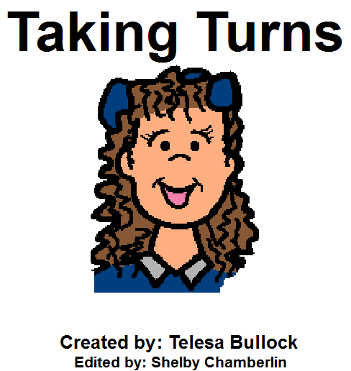
Being Bossy created by Telesa Bullock
Family Programming Teacher SD 76
Edited by Shelby Chamberlin, MSW Intern 2014

Slide 2
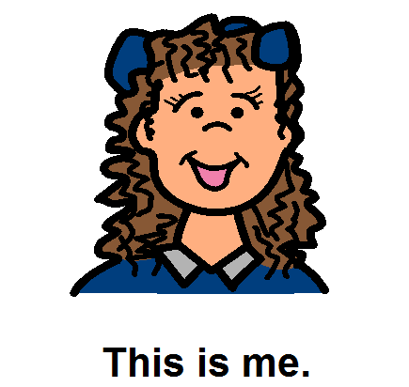

Slide 6
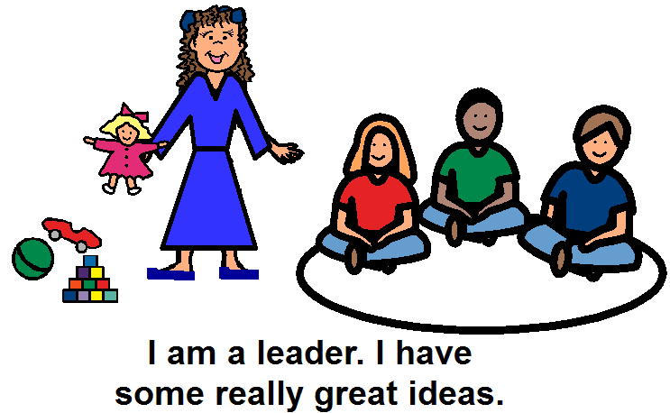

Slide 7
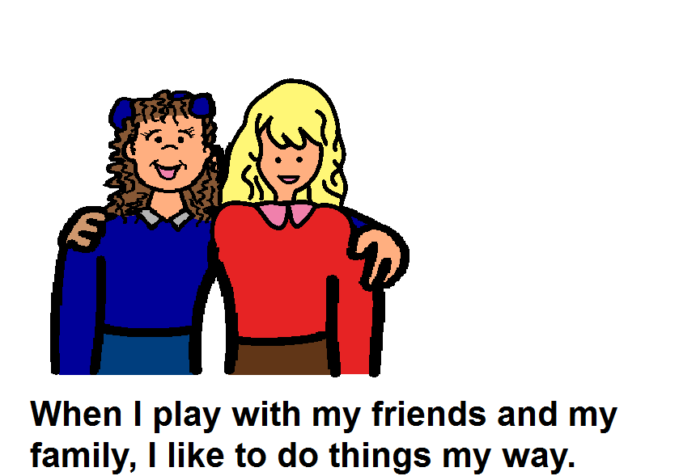

Slide 8
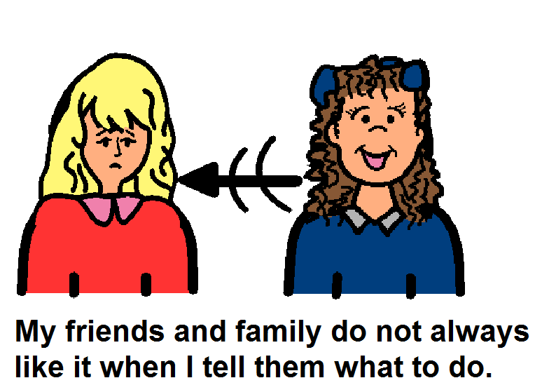
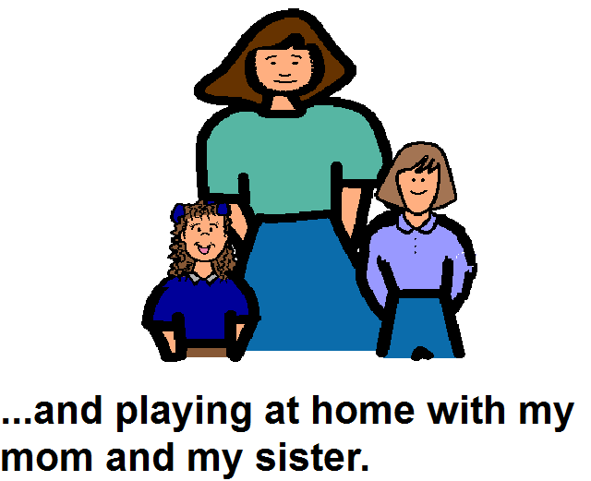

Slide 10
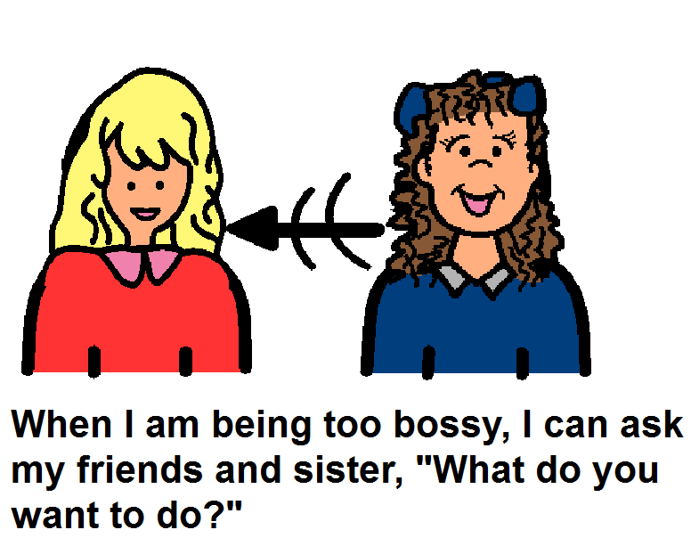
What do you want to do?

Slide 11
