Slide 1
My Family
By Dawn Varney
Edited by Add names of staff and family members who assist

Slide 2
Social Stories
Social Stories help children to learn different skills. Many children’s stories address topics that are useful to children and provide ideas about how to resolve them.
This is a social story intended for children living in non-traditional families.
Many of these children have questions about their situation and have experiences different levels of loss or trauma.
This book is intended to be edited to fit the needs of each individual family situation. You may edit the words and pictures as appropriate.
Use photos as available to make this more meaningful
This is a good tool to help the child understand his/her family dynamics and manage some of the complexities.

Slide 3
My name is Alanna.
Add picture

Slide 4
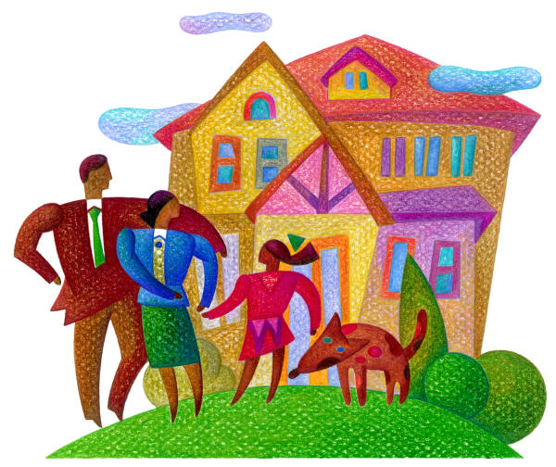
I have a family and my family is different.

Slide 5
Some children live with a mom and dad. I live with My Nana and Grampa.
Add pictures or clip art that represent family

Slide 6
Sometimes I wonder why my family is different and it makes me sad.

Slide 7
Then I remember that I have a family who loves and cares for me.

Slide 8

We also have a dog named .

Slide 9

I have a family who loves and cares for me. I have _____________________________.

Slide 10
Sometimes I Visit ______________
I like to go for visits because…

Slide 11
I always go home to My House with Nana and Grandpa.

Slide 12


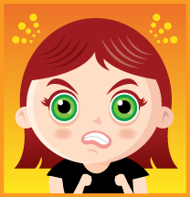
Sometimes I get mad or sad after my visit. List some reasons Why.

Slide 13
I know that There are all different Families.
It is not my fault, that I do not live with my Mom and Dad.

Slide 14
I have a family who loves and cares for me.

Slide 15
When I am mad or angry I feel like hitting, kicking and yelling. I know that it is not kind.

Slide 16
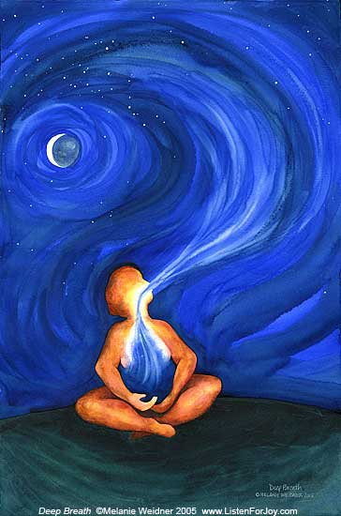
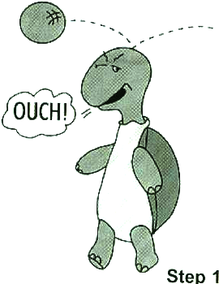
When I am Mad or Sad I can use my words to tell someone. I can Act like a Turtle.
Step 1

Slide 17
When I am happy, I like to play and draw, and read books.

Slide 18
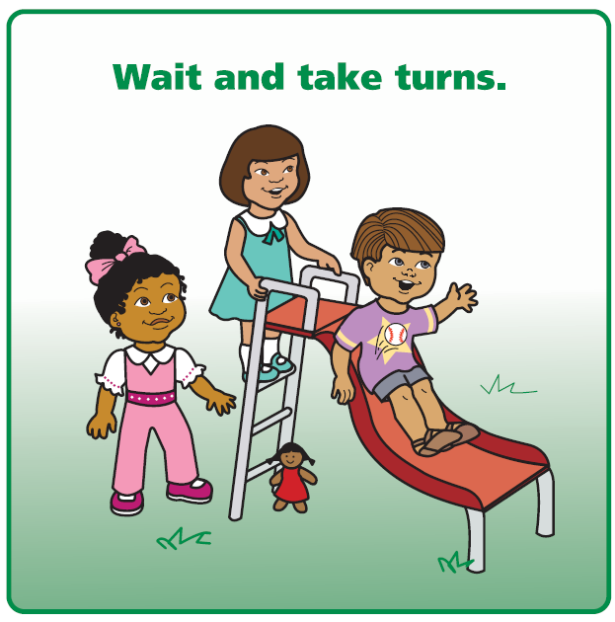
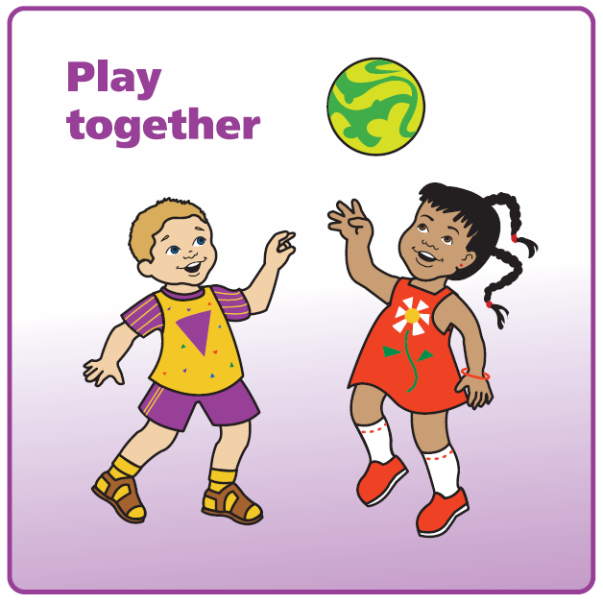
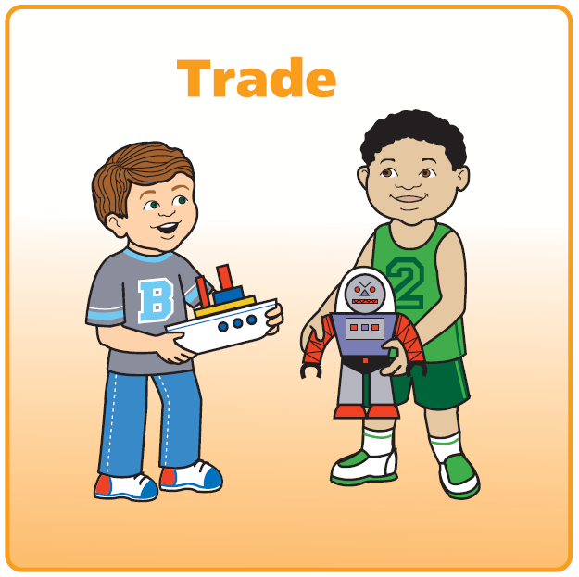
They have rules for me at home. I have to be kind to my family just like I do at school. I have to make safe choices and I have to take care of my things.
Be Safe
Be Kind
Be Careful
With Our Things

Slide 19


I can talk about my feelings and what makes me Mad or Sad with Enter person’s name. It helps me feel better.

Slide 20
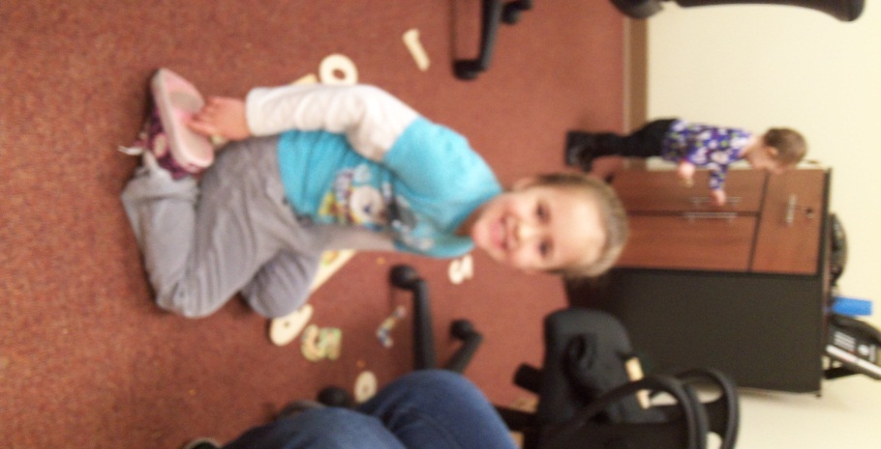
I have a family who loves and cares for me.

